Slide 1


Employee Management system
CENTURION UNIVERSITY OF TECHNOLOGY AND MANAGEMENT
Y.SAI (211801370067)
P.VIJAY KUMAR (211801370098)
CH .VAMSI (211801370088)
Y.KHAGESHWAR RAO (211801370104)
G.GNANESWARAO (211801370115)
GUIDE :
Mrs.G.RAMADEVI

Slide 2
Abstract
Employee management system is an application based system, having two applications developed, one for employers to manage employee details and another for employees to mark their attendance. Every organisation whether government or private uses an information system to store data of their staff. However, in India it is found that many small scale industries use pen and paper to keep a record. However, there are many advanced technology systems available that can do this work but they all are costly for these low level industries

Slide 3
Introduction
Employee Management System is a distributed application developed to maintain the details of employees working in any Organization.
It maintains the information about the personal and official details of the employees.
The EMS has been developed to override the problems prevailing in the practicing the manual system.

Slide 4
Objective
This project aims to simplify the task of maintaining records of the employees of company.
To develop an well-designed database to store employee information.
Provides full functional reports to management of the company,
And its provide a comprehensive approach towards the management of employee information.

Slide 5
Existing System
The records are maintained in regsiters.
Time Consuming process
Complicated Searching, editing and updating.

Slide 6
Proposed System
Helps in maintaining the computerized employee details
Calculate the salary
Easy attendance marking
Easy calculation of various leave in categories
Create new users to the system accordingly

Slide 7
Software required
Name of the Component​ | Specification​
Operating System​ | Windows 7, Linux​
Language​ | HTML , CSS, Java Script, PHP​
Database ​ | MySQL Server​
Browser​ | Mozila Firefox, Chrome, Opera​
Scripting Language​ | Java Script​
Database JDBC Driver​ | MySQL Jconnector​

Slide 8
Hard Ware Required
Name of Component ​ | Specification​
Processor​ | Pentium III 630MHz​
Ram​ | 128 MB​
Hard Disk​ | 20 GB​
Monitor​ | 15 " color Monitor​
Key Board​ | 122 Keys​

Slide 9
Modules
Administrator | Employee
Employee | Employee
Finance | Allowance
Attendance | Attendance
Leave | Leave
Performance | Log Off
Log Off

Slide 10
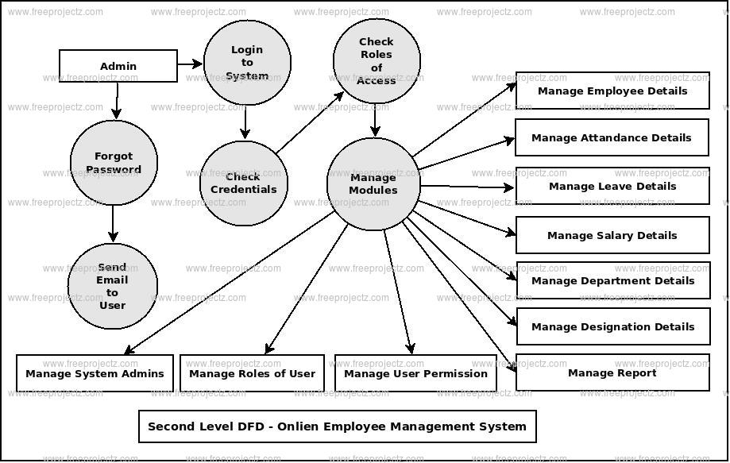
Basic Diagram

Slide 11
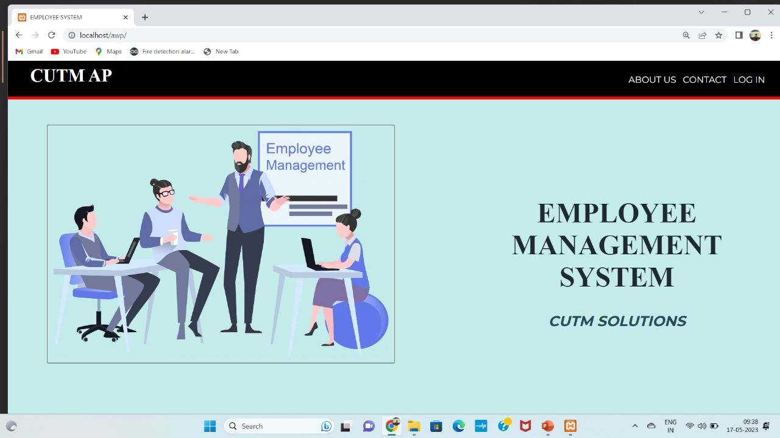
Employee interface

Slide 12
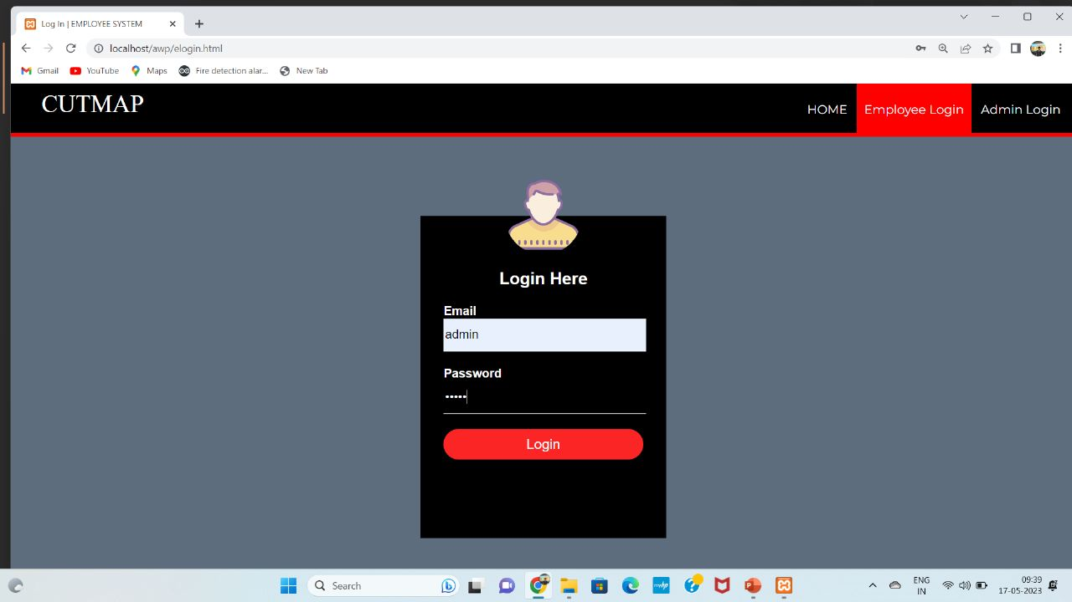
Employee login

Slide 13
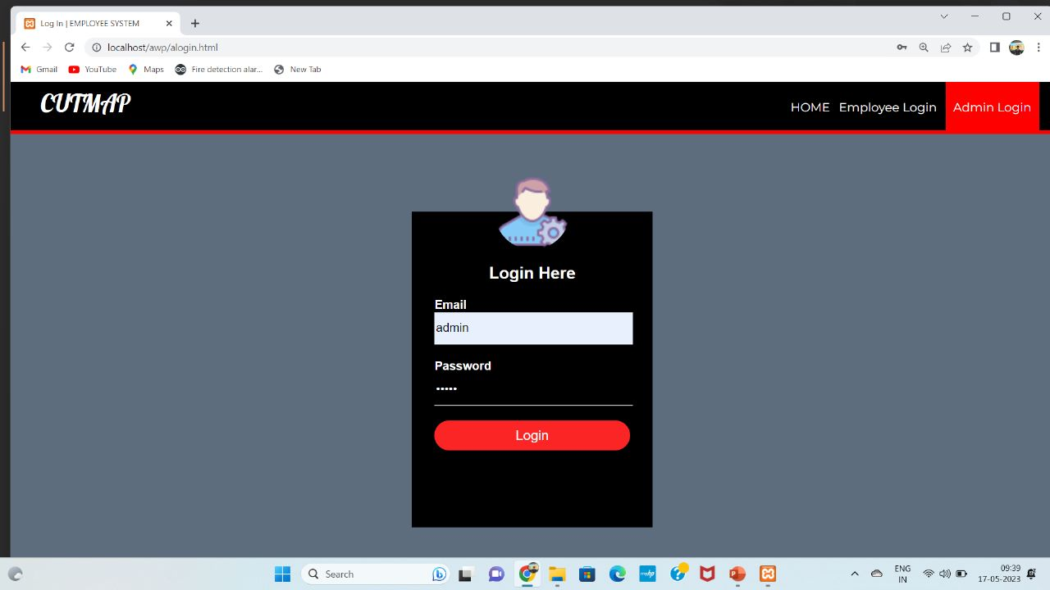
Admin login

Slide 14
References
Employee Management System (slideshare.net)
https://www.campcodes.com/tag/employee-leave-management-system-project/

Slide 15


Thank you

